Slide 1
Spark-HPCC: HPCC with Spark
Vivek Nair
Software Engineering Intern
Mentor: Dan Camper

Slide 2
Problem Statement
Objective: Interoperability between HPCC and Spark
Spark->HPCC: Run Spark program (from Spark Shell) using data from HPCC
HPCC->Spark: Call Spark program (as sub-routine) from within ECL program (using ECL IDE)
Side-Effects:
Can be used with ANY application by treating HPCC thor files as a local file
Can be used by analyst for quick exploration of data.
Technologies used:
Python FUSE - Filesystem in User space
Apache LIVY - is a service that enables interaction with a Spark cluster over a REST interface

Slide 3
Agenda
Motivation
Introduction
Possible Solutions
Spark-HPCC: FUSE-based Solution
Spark->HPCC
HPCC->Spark
Future Work

Slide 4
Agenda
Motivation
Introduction
Possible Solutions
Spark-HPCC: FUSE-based Solution
Spark->HPCC
HPCC->Spark
Demonstration
Future Work

Slide 5






Context

Slide 6
Agenda
Motivation
Spark-HPCC: Introduction
Design
Spark->HPCC
HPCC->Spark
Demonstration
Future Work

Slide 7

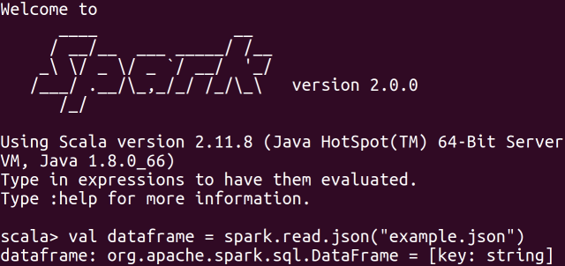

Spark-HPCC
FUSE plugin which can mount HPCC clusters as a local drive
Spark->HPCC: Run Spark program using data stored in HPCC
HPCC->Spark: Run Spark program as ECL sub-routine
HPCCFuseJ
ESP
Spark Shell
ECL-IDE

Slide 8

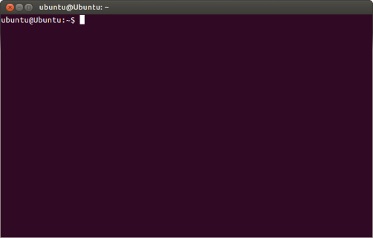


Spark-HPCC: Side Effect
HPCCFuseJ
ESP

Slide 9
Agenda
Motivation
Spark-HPCC: Introduction
Design
Spark->HPCC
HPCC->Spark
Demonstration
Future Work

Slide 10
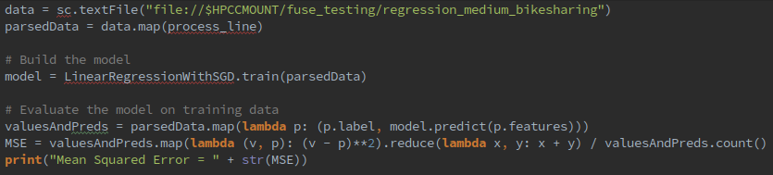
Spark->HPCC: Run Spark using data from HPCC
2
1. Mount HPCCFuseJ on the Spark master
HPCC Cluster IP
Port
Local mount point
1
2. Run pySpark program
- Treat HPCC files as local files
HPCCFuseJ

Slide 11
Agenda
Motivation
Spark-HPCC: Introduction
Design
Spark->HPCC
HPCC->Spark
Demonstration
Future Work

Slide 12
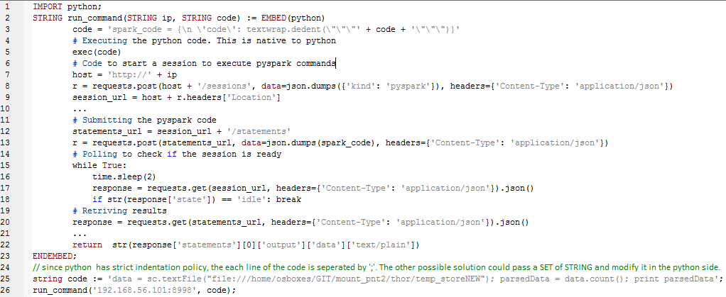

HPCC->Spark: Run Spark from ECLIDE
4
1. Mount HPCCFuseJ on the Spark master
2. Submit job to HPCC
HPCCFuseJ
3. Submit Spark Job using LIVY
4. Poll to check the status of the job
5
5. Return results to HPCC
3
2
1

Slide 13
Agenda
Motivation
Spark-HPCC: Introduction
Design
Spark->HPCC
HPCC->Spark
Demonstration
Future Work

Slide 14
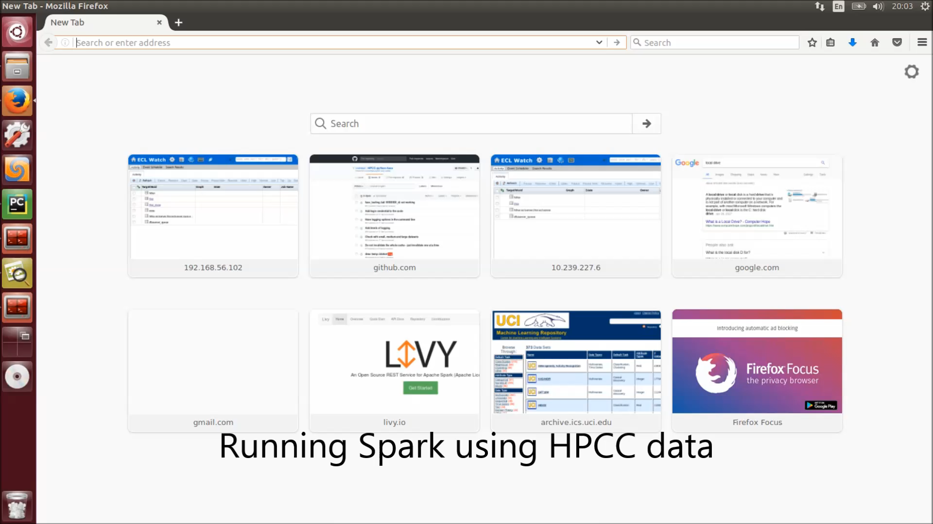

Slide 15
Agenda
Motivation
Spark-HPCC: Introduction
Design
Spark->HPCC
HPCC->Spark
Demonstration
Future Work

Slide 16
Future Work
Remove bottleneck
Streaming Data
Data needs to be persisted (saved) before executing Spark
Can data be streamed from HPCC to Spark rather than persisting?
Current
Proposed
HPCCFuseJ
HPCCFuseJ
Performance Report: tiny.cc/hpccfusej_perf
Expected: April 2018
Expected: April 2018
vnair2@ncsu.edu
vivekaxl.com
Thank you

